Slide 1










Neural Machine Translation with Transformers
2021465
2021758

Slide 2
















01
What is a Transformer?
Attention is all you need
03
Encoder-decoder structure, multi-head self-attention, and feed-forward layers.
Background on Transformers
This report will give all the information you need about Transformers
02
Why Transformers?
English-Urdu Challenges
04
Transformers excel in seq2seq tasks, especially for low-resource languages, by leveraging attention mechanisms.
Urdu’s unique features (Perso-Arabic script, right-to-left writing, morphological complexity) and data scarcity issues.

Slide 3


DATA
English.txt
Urdu.txt
contains lines of Urdu translated text corresponding to the English.txt files with ordering
Contains lines of English text

Slide 4







METHODOLOGY
Transformer
Encoder Layers and Modules
Decoder Layers and Modules
Transformer Module

Slide 5









METHODOLOGY
Building Vocab, Dataprocessing and creating dataloaders
Splitting the dataset into 70,15,15
Reading Eng and Urdu Data
Creating 3 different files (train, test, validate) for both english and Urdu
Training Phase, used 80 epochs

Slide 6
METHODOLOGY
Decoding
Translation
After the training part we decode it to translate it
For this part the model was performing well for train data

Slide 7
BLEU AND METEOR METRIC
BLEU measures translation quality by comparing machine-generated text to human references, focusing on n-gram precision. Higher BLEU scores indicate translations closer to human quality, though it may undervalue fluency.
METEOR evaluates translations by considering synonyms, stemming, and word order, aligning more closely with human judgment.

Slide 8


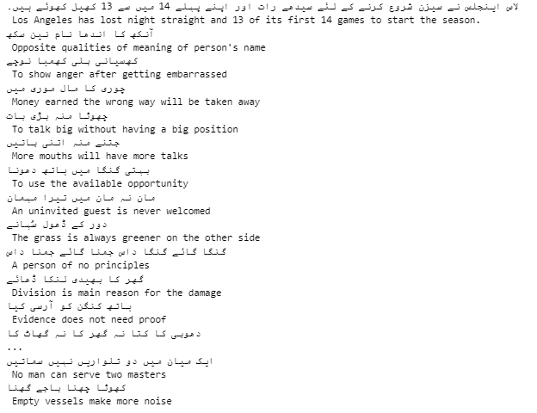
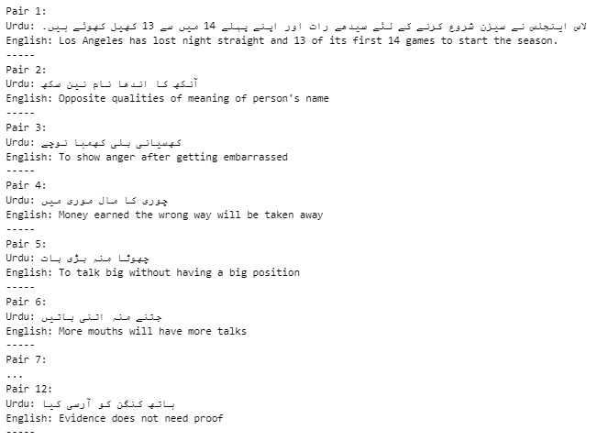
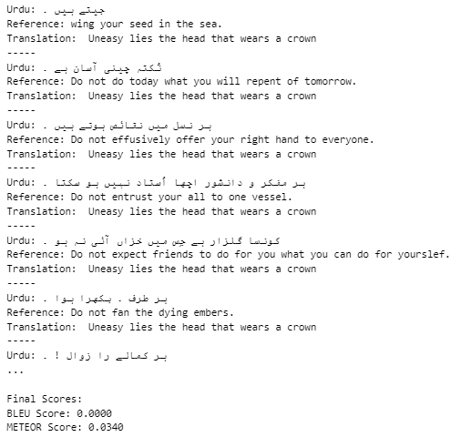


RESULTS FOR THE CUSTOM TRAINED MODEL
Constraints added till now are the Evaluation Metric Bleu & METEOR
Now, we will use HuggingFace Pre-trained Model and make it better
Training
Validation
Bleu & METEOR

Slide 9

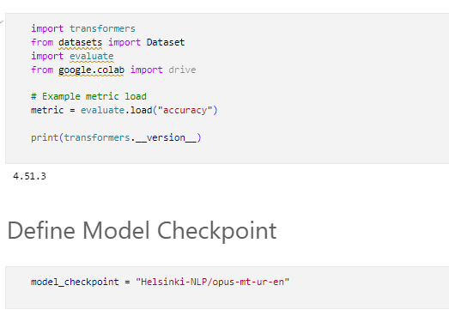
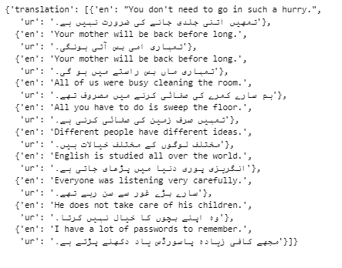
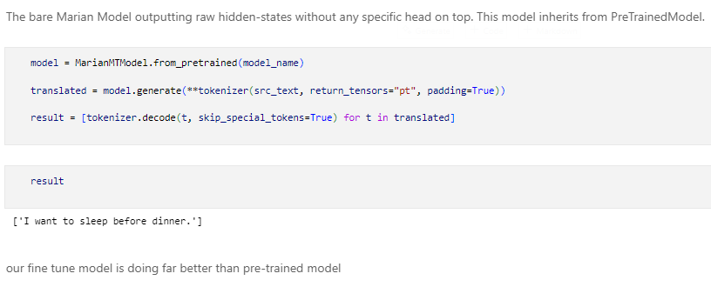
PRE-TRAINED HUGGING-FACE MODEL
Used MarianMT [Helsinki mt-opus-ur-en] model

Slide 10



THANK YOU!!!
REPORT AND CODE FILES WITH THE REPO ARE INCLUDED IN THE ZIP FILE

